Slide 1

Chapter 2
Beliefs, Values, and Health

Slide 2
Learning Objectives (1 of 2)
Concepts of health and disease, risk factors, and role of health promotion and disease prevention
Disease prevention requisites under the ACA
Public health and its expanding role in health protection in the U.S. and globally
Determinants of health and measures related to health

Slide 3
Learning Objectives (2 of 2)
American anthro-cultural values and their implications for health care delivery
Justice and equity in health care according to contrasting theories
Integration of individual and population health

Slide 4
Introduction
10-year Healthy People initiatives
Influence of anthro-cultural factors
Evolution of health services
Equity in the distribution of health services

Slide 5
Significance for Managers and Policymakers
Health of a population determines health care utilization.
Design appropriate educational, preventive, and therapeutic initiatives.
Evaluating the effectiveness of health care organizations.
Measures of health status and utilization.

Slide 6
Basic Concepts of Health
Health
The medical model defines health as the absence of illness or disease.
Sociologists define health as the state of optimal capacity.
Biopsychosocial model.
Holistic view.

Slide 7
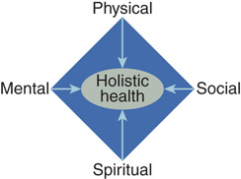
Figure 2-1: The Four Dimensions of Holistic Health.

Slide 8
Quality of Life
Overall life satisfaction during and following health care delivery system encounter
Indicator of how satisfied a person is with their health care experience
Overall satisfaction with life and self-perceptions of health after intervention

Slide 9
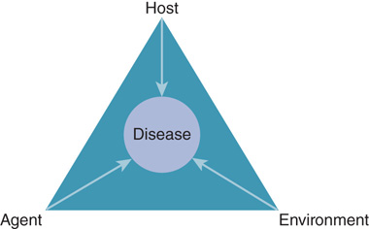
Risk Factors and Disease (1 of 3)
Risk factors increase the likelihood of developing a particular disease or health condition.
Epidemiology Triangle
Figure 2-2 The Epidemiology Triangle.

Slide 10
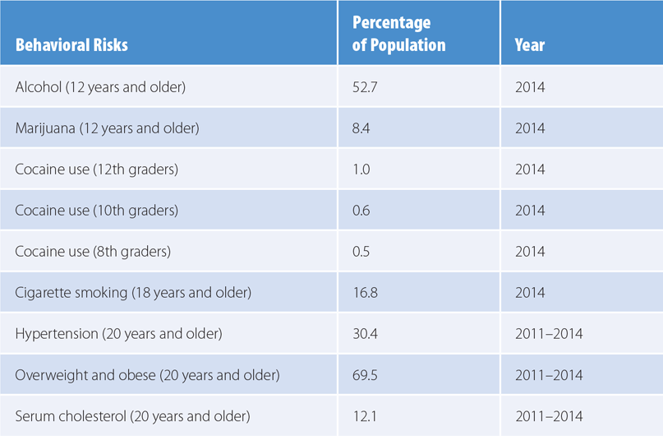
Risk Factors and Disease (2 of 3)
Behavioral risk factors
Table 2-1 Percentage of U.S. Population with Behavioral Risks
Data from National Center for Health Statistics (NCHS). 2016. Health, United States, 2015. Hyattsville, MD: Department of Health and Human Services. pp. 2, 192, 194, 202, 216.

Slide 11
Risk Factors and Disease (3 of 3)
Acute, subacute, and chronic conditions
Three reasons for the rise of chronic conditions
New diagnostic methods, medical procedures, and pharmaceuticals
Screening and diagnosis
Lifestyle choices

Slide 12
Health Promotion and Disease Prevention
Three principles of a health promotion and disease prevention program
Health risk appraisal
Interventions for counteracting the key risk factors
Adequate public health and social services

Slide 13
Disease Prevention Under the Affordable Care Act
Prevention and Public Health Fund (PPHF)
CDC established the National Diabetes Prevention Program (NDPP)
Organizations nationwide offer diabetes prevention lifestyle programs
Funding to establish and evaluate comprehensive workplace wellness programs

Slide 14
Public Health
Public health deals with promoting optimal health for the society as a whole.
Health protection and environmental health.
Health protection during global pandemics.
Protecting populations from a variety of old and new threats through global cooperation

Slide 15
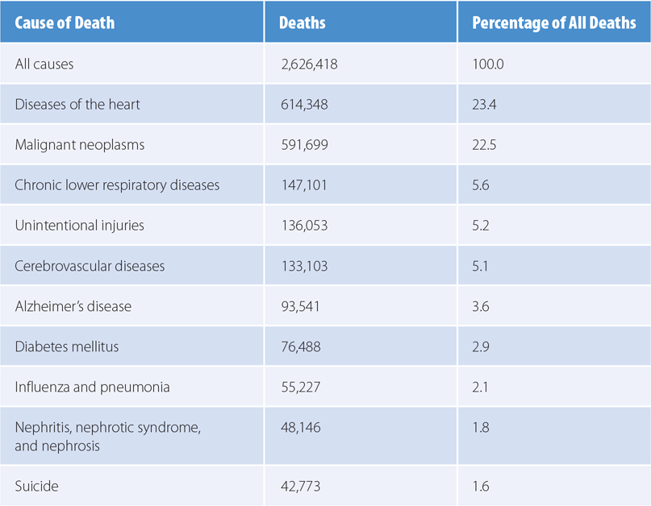
Table 2-3: Leading Cause of Death, 2014
Data from National Center for Health Statistics (NCHS). 2016. Health, United States, 2015. Hyattsville, MD: Department of Health and Human Services. p. 107.

Slide 16
Health Protection and Preparedness in the U.S.
Dealing with threats requires large-scale preparations.
Tools and training for workers in medical care
Public health
Emergency care
Civil defense agencies at the federal, state, and local levels

Slide 17
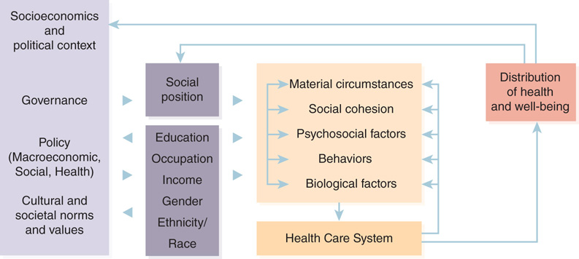
Determinants of Health (1 of 2)
Blum’s model of health determinants
Environment
Lifestyle
Heredity
Medical care
Figure 2-3 WHO Commission on Social Determinants of Health conceptual framework.
Reproduced from Centers for Disease Control and Prevention (CDC). 2010a. Establishing a holistic framework to reduce inequities in HIV, viral hepatitis, STDs, and tuberculosis in the United States. Available at: https://www.cdc.gov/socialdeterminants/docs/SDH-White-Paper-2010.pdf. Accessed April 2017. Modified from Solar O., and A. Irwin; World Health Organization (WHO). 2010. A conceptual framework for action on the social determinants of health. Social Determinants of Health Discussion Paper 2 (Policy and Practice). Geneva, Switzerland: WHO.

Slide 18
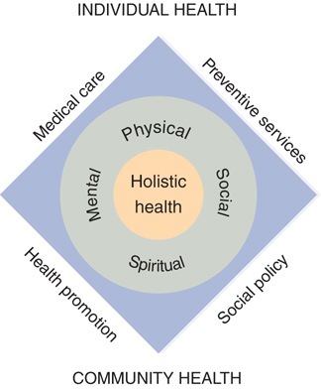
Determinants of Health (2 of 2)
Contemporary models of health determinants
Figure 2-4 Integrated model for holistic health.

Slide 19
Measures Related to Health (1 of 3)
Measures of physical health
Morbidity
Mortality
Demographic change
Births
Migration

Slide 20
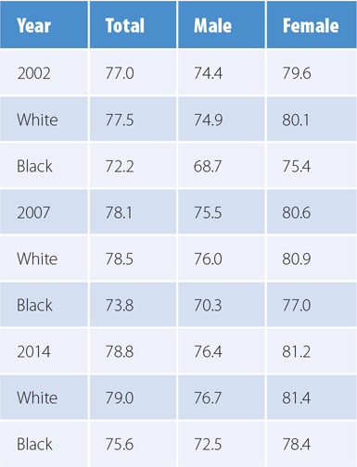
Table 2-4 U.S. Life Expectancy at Birth—2002, 2007, and 2014
Data from National Center for Health Statistics (NCHS). 2016. Health, United States, 2015. Hyattsville, MD: Department of Health and Human Services. p. 95.

Slide 21
Measures Related to Health (2 of 3)
Measures of mental health
Measures of social health
Breslow’s social health dimensions
Social contacts and social resources
Measures of spiritual health

Slide 22
Measures Related to Health (3 of 3)
Measures of health services utilization
Crude measures of utilization
Specific measures of utilization
Measures of institution-specific utilization
Measures of global health
Direct indicators of global health
Indirect indicators of global health

Slide 23
Anthro-Cultural Beliefs and Values (1 of 2)
Beliefs and values in the American culture
Belief in scientific advancement and the application of scientific methods to medicine
Champion of capitalism
Culture of capitalism promotes entrepreneurial spirit and self-determination
Principles of free enterprise and a general distrust of big government

Slide 24
Anthro-Cultural Beliefs and Values (2 of 2)
Equitable distribution of health care
Market justice
Social justice
Justice in the U.S. health care delivery system
Limitations of market justice

Slide 25
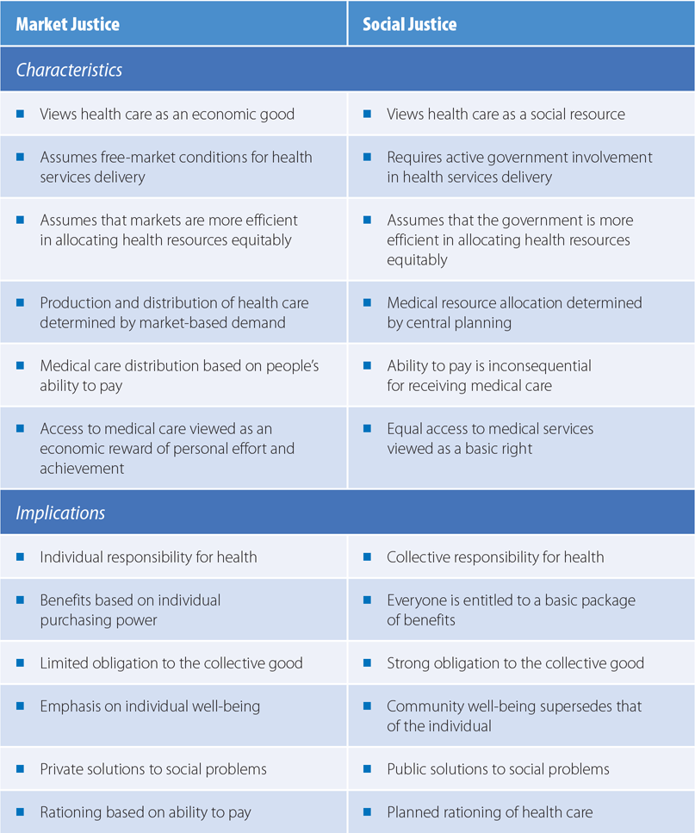
Table 2-5 Comparison of Market Justice and Social Justice

Slide 26
Integration of Individual and Population Health
Healthy People initiatives
See Figures 2-5 and 2-6
Healthy People 2020
Measurement of Healthy People 2020
Achievement of Healthy People 2020

Slide 27
Summary
Medical model of health care delivery emphasizes illness rather than wellness.
Understanding health determinants.
Healthy People 2020 continues its goals.
Contrasting theories of market justice and social justice.

